Slide 1
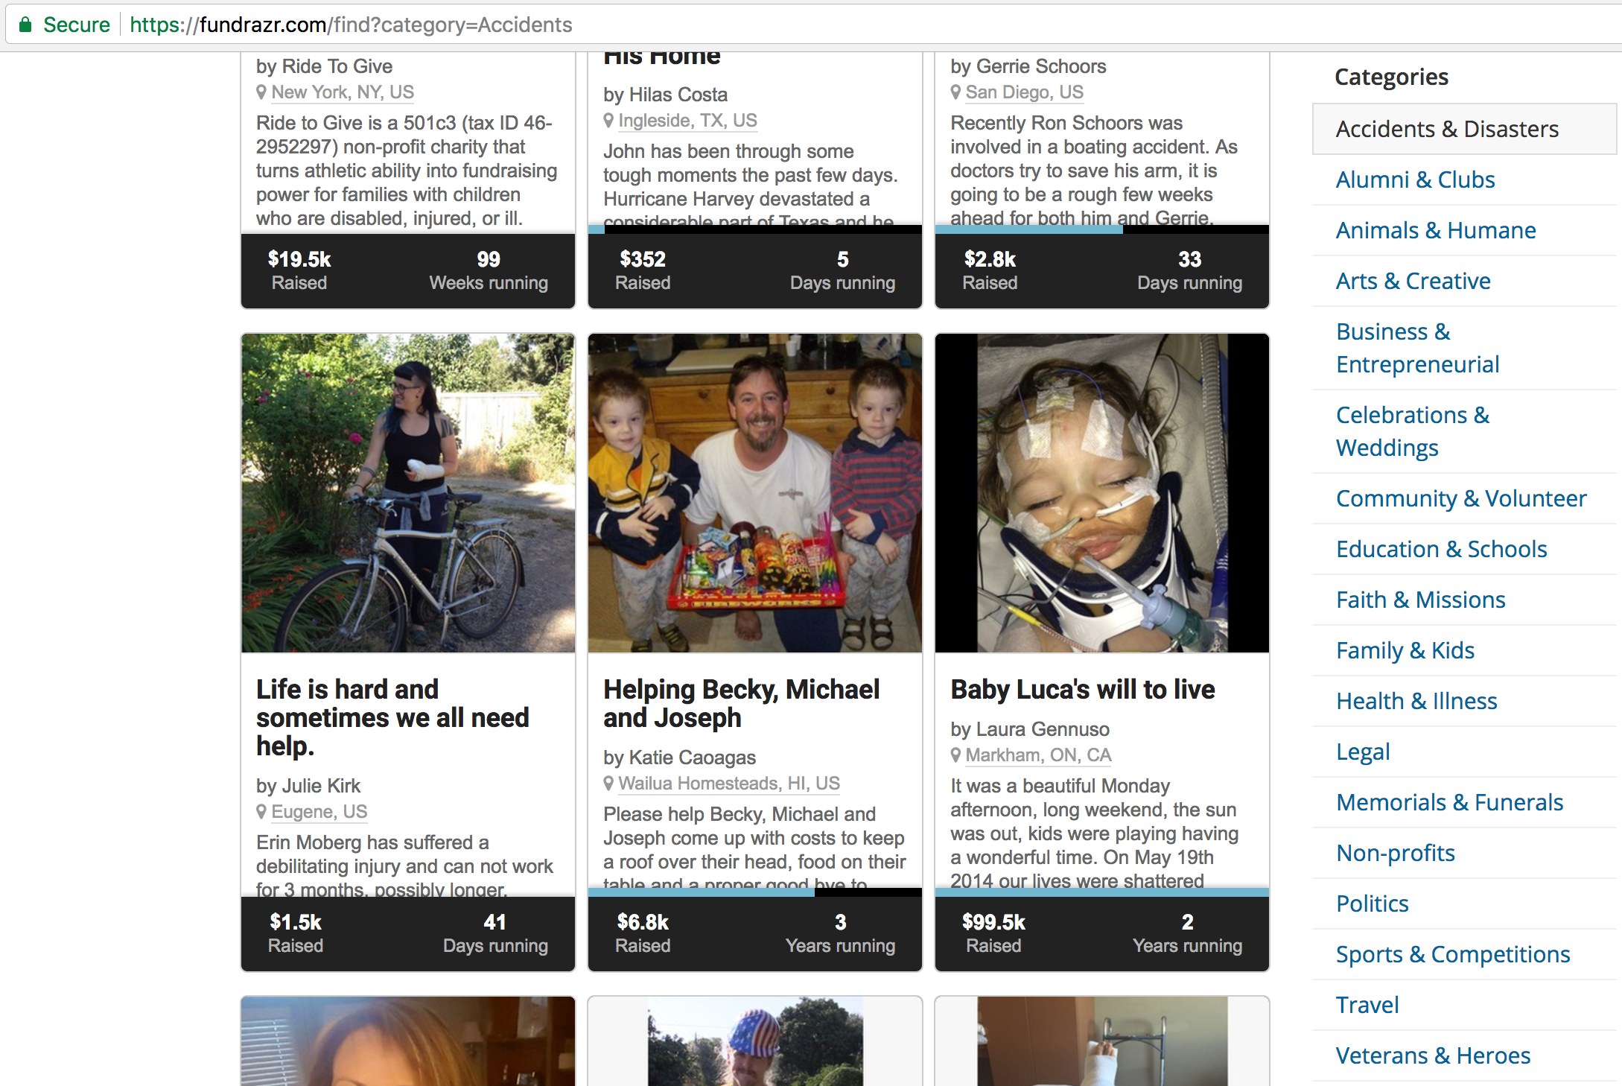
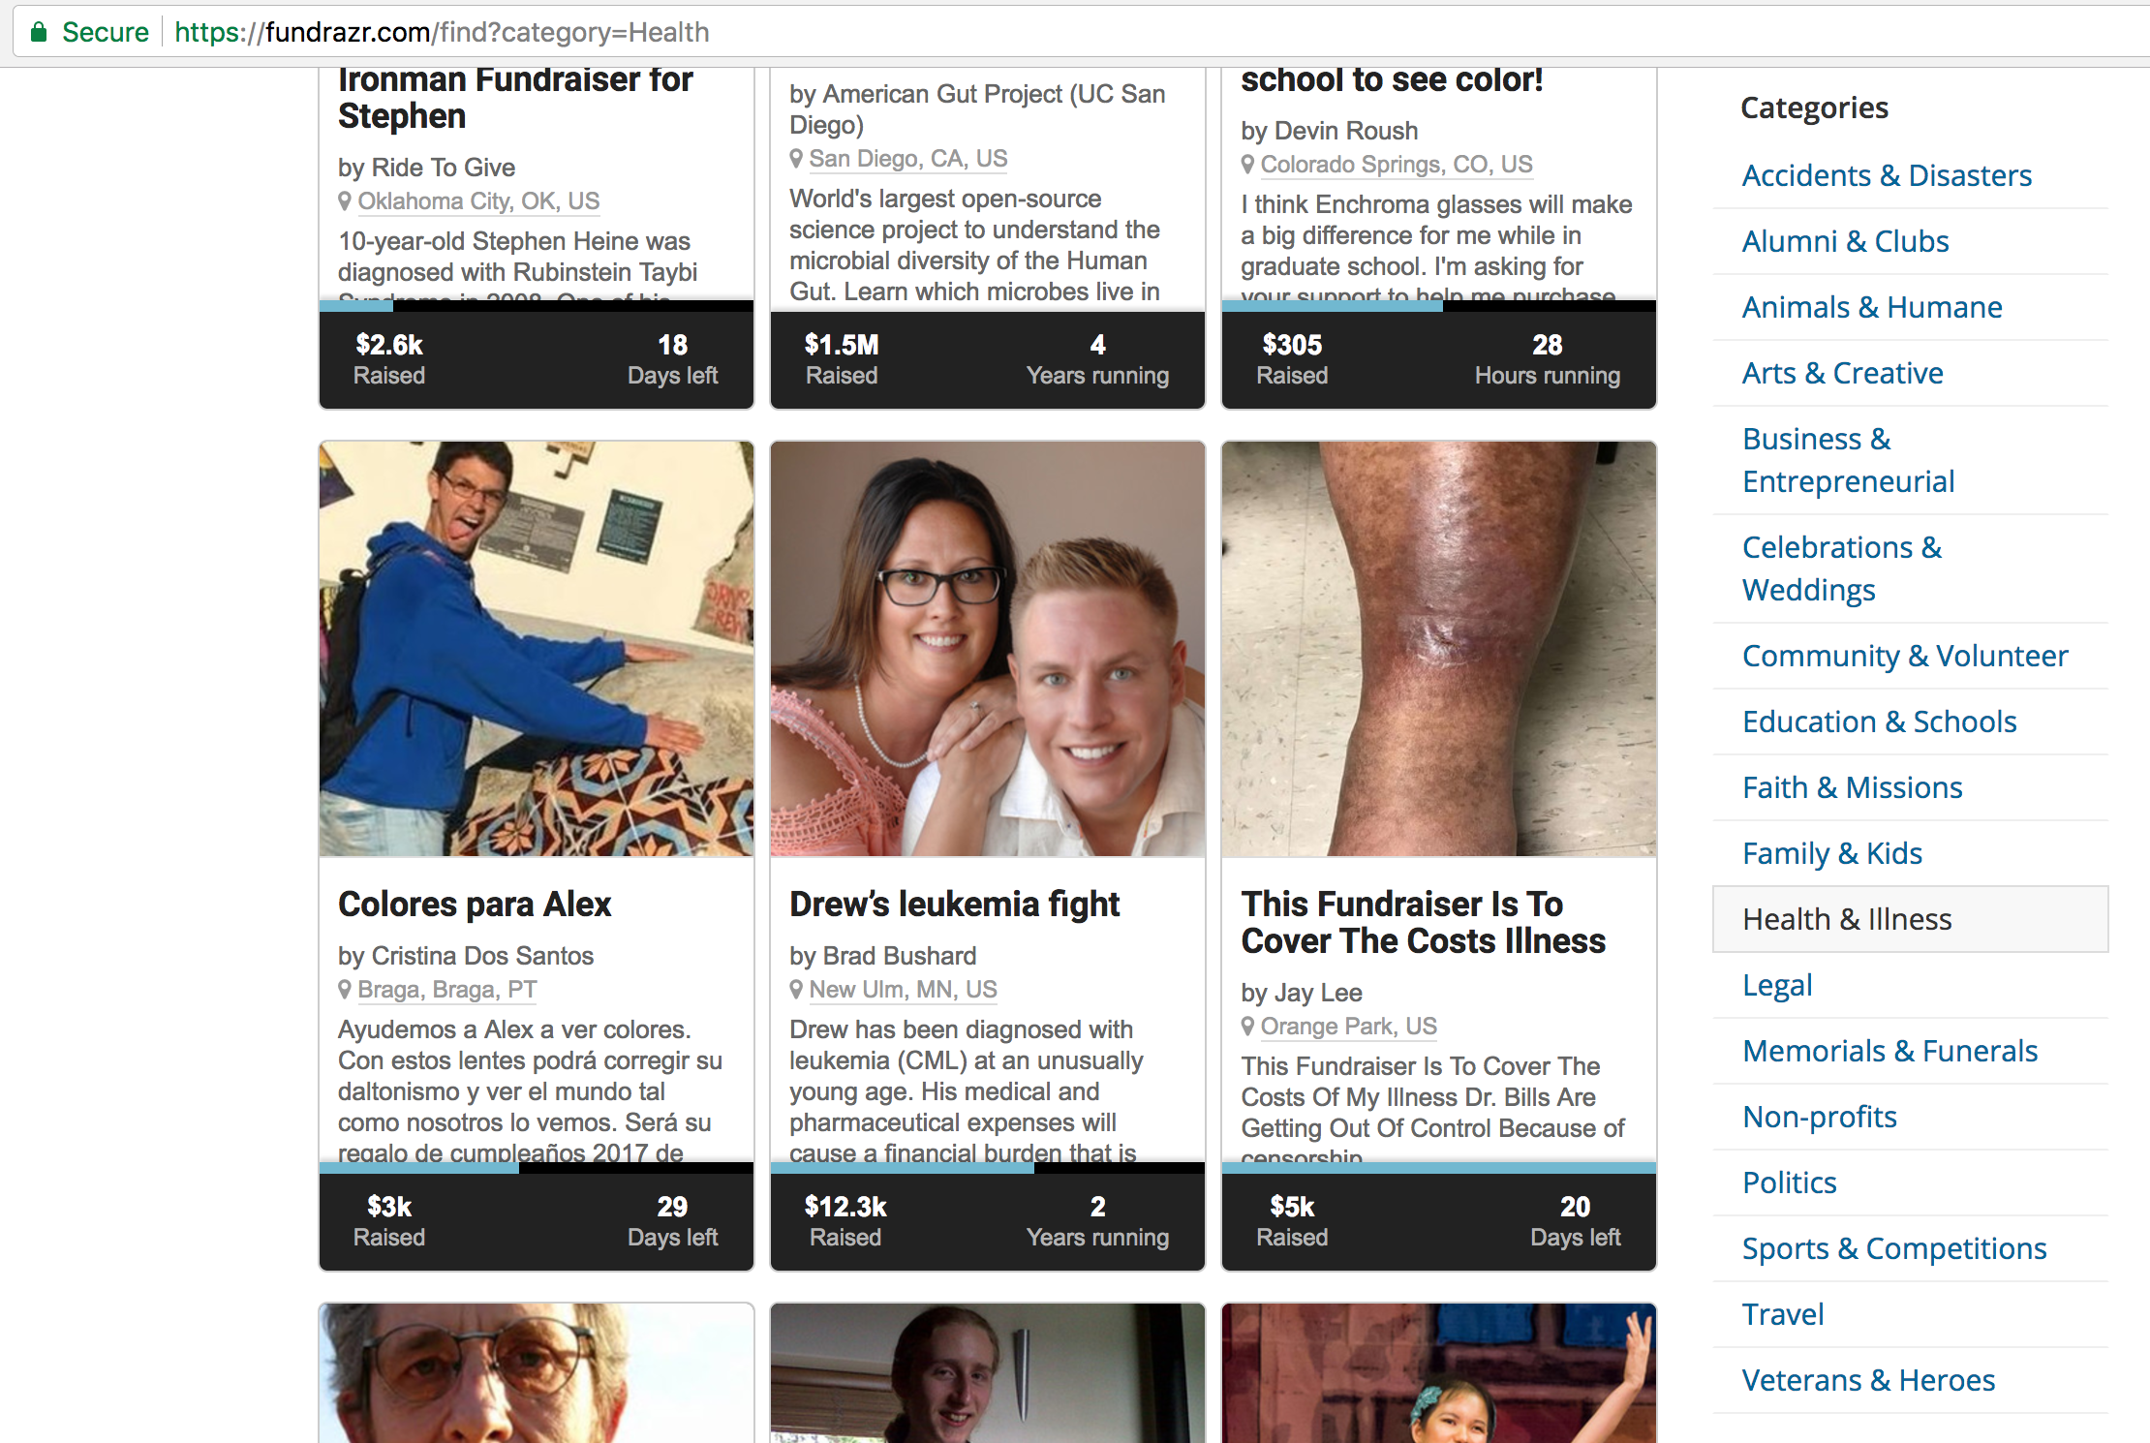

Slide 2
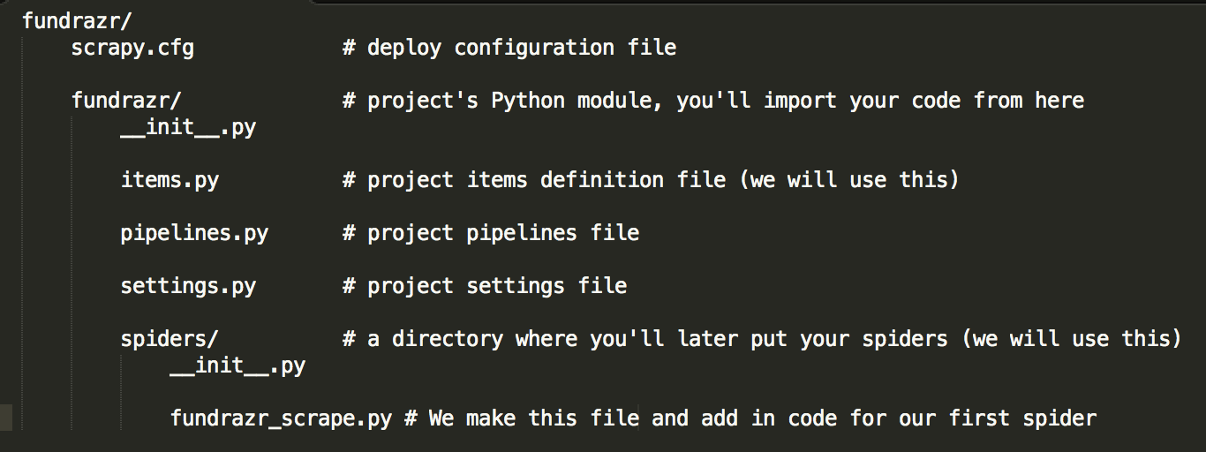

Slide 3
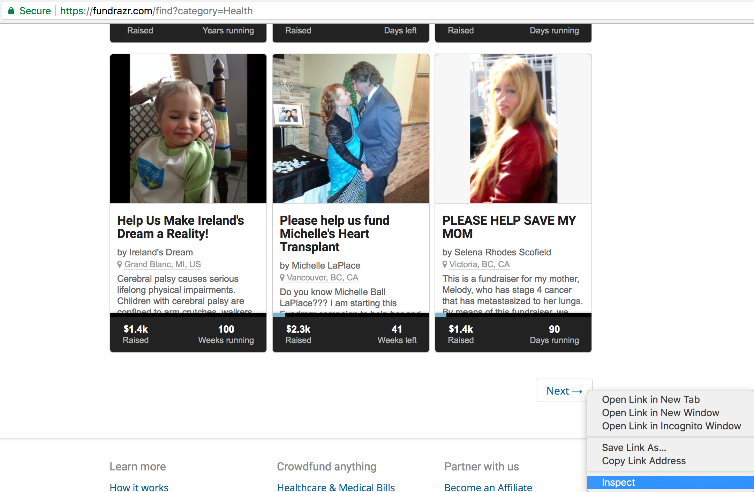
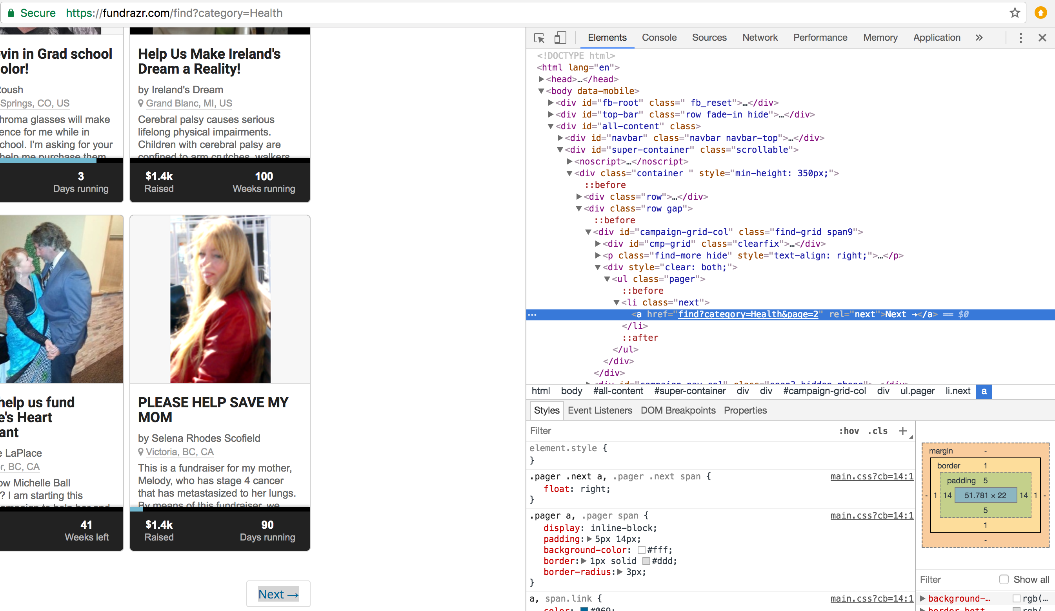
Right click on the ”Next” button (enclosed within the red rectangle) and then click on Inspect
The highlighted portion in blue just means we append the following to our url (if we want another page of fundraisers): find?category=Health&page=2

